Slide 1

r/place Bot Analysis
Jacob Schoenburg, Parker Petersen, Mehrpad Moattari, Ollie Sheehan

Slide 2

Bot Criteria
How :
Filtered data to include only users who made 15 or more posts.
Calculated the time difference between each post made by the same user.
Users who had extremely consistent post timing (within .5 seconds) were marked as suspected bots.

Slide 3

Bots by the Numbers
569,073
6.5
35,142,650
Total # of Bots
% of Users are Bots
# of Bot Posts

Slide 4
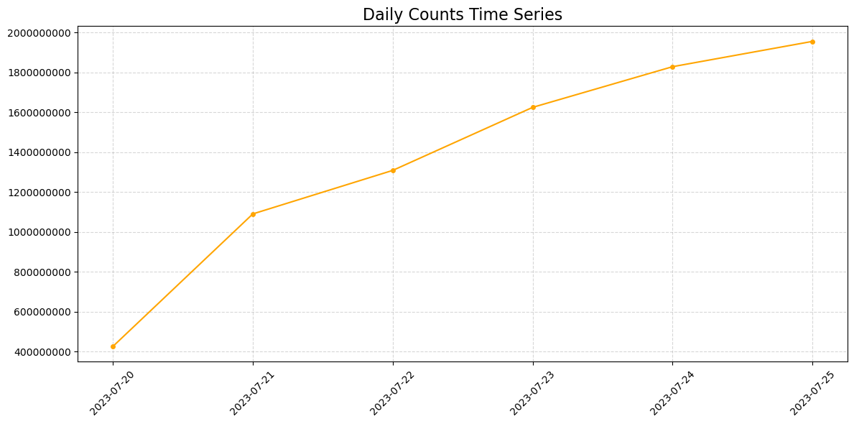
Bots Daily Counts

Slide 5
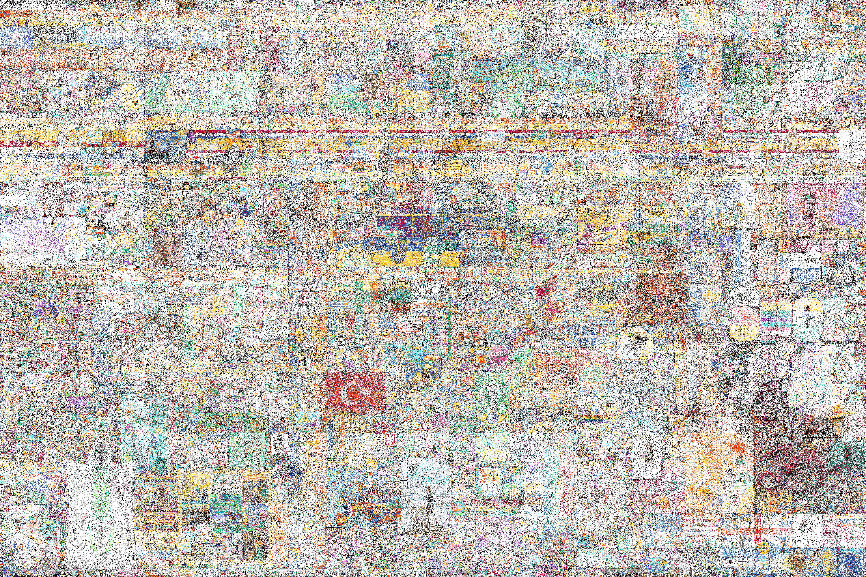
Estimated Bots Activity

Slide 6
Thank you! Any questions? “When we wrote the code, only God and our team understood what we did. Now only God knows.”

